Slide 1
Module 7

Slide 2

CONSTRUCTIONS
To construct triangle similar to given triangle
Notes:
School
2

Slide 3
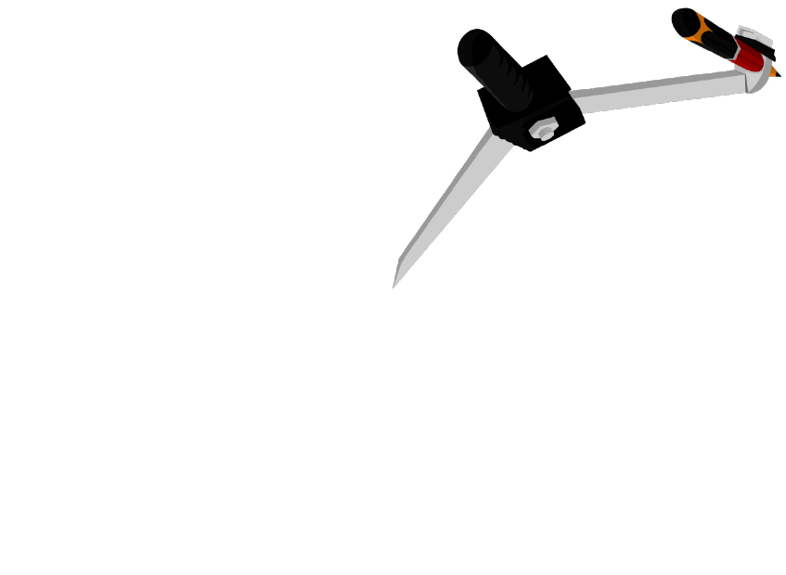
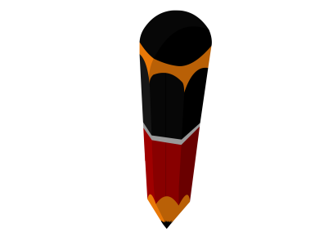
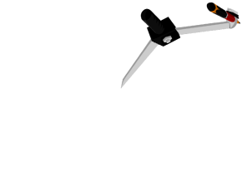



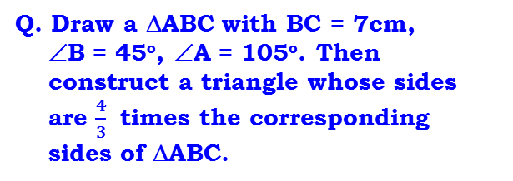
Rough Figure
A′
Q. Draw a ΔABC with BC = 7cm,
∠B = 45º, ∠A = 105º. Then
construct a triangle whose sides
are $\frac{4}{3}$ times the corresponding
sides of ΔABC.
B as centre and any suitable radius draw arcs intersecting BZ and BC at P and Q respectively
Any point on the line as centre and radius = 7 cm, draw an arc
C as the centre and same radius, draw another arc
B as centre and any suitable radius, draw arcs intersecting BC at X and Y
X as centre and radius more than half of XY draw an arc
P as centre and radius more than half of PQ, draw an arc
Q as centre and same radius cut the previously drawn arc
Y as centre and with the same radius cut previously drawn arc
S as centre and radius more than half of ST, draw an arc
A
C as centre any suitable radius draw an arc intersecting BC at point S
A
S as centre and same radius cut previously drawn arc
T as centre and same radius cut previously drawn arc
Draw ray BZ
Draw seg BC = 7cm
Draw ray BR
Draw ray CU
105º
Z
105⁰
P
R
U
T
45º
30º
A′B
BC′
A′C′
4
1
2
3
4
5
6
7
8
9
10
11
12
13
=
=
=
B
7 cm
C
C′
14
15
1
2
3
4
5
6
7
8
9
10
11
12
13
14
15
AB
BC
AC
3
45º
30⁰
X
B
Q
Y
7 cm
S
C
1
2
3
1
2
3
4
5
6
7
8
9
10
11
12
13
14
15
4
5
6
7
8
9
10
11
12
13
14
15
In ΔABC,
∠A + ∠B + ∠C = 180º
∴ 105 + 45 + ∠C = 180
∴ 150 + ∠C = 180
∴ ∠C = 180 – 150
∴ ∠C = 30º
1
2
3
4
5
6
7
8
9
10
11
12
13
14
15

Slide 4
Module 8

Slide 5
CONSTRUCTIONS
To construct triangle similar
to given triangle
(continuation of previous module)
Notes:
School
5

Slide 6
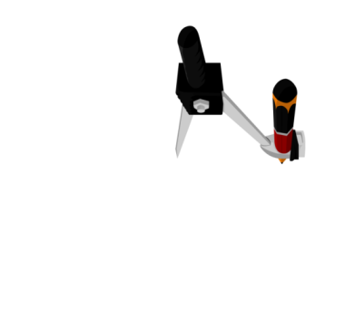
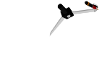

Ex-13.1 (Q.6)
Rough Figure
Q. Draw a ΔABC with BC = 7cm,
∠B = 45º, ∠A = 105º. Then
construct a triangle whose sides
are $\frac{4}{3}$ times the corresponding
sides of ΔABC.
A′
Now consider Radius = HI
Now consider Radius = DE
C as centre, and any suitable radius draw an arc intersecting BC and AC at point H & I respectively
A'
B₃ as centre, and any suitable radius draw an arc intersecting BO and B₃C at point D & E respectively
Now, C' as centre and with the same radius, Draw an arc intersecting BC at J
Now, B₄ as centre and with the same radius, Draw an arc intersecting BO at F
A
Considering any suitable radius, draw 4 arcs on ray BO
Draw C'K intersecting AC at A'
A
Draw B₄G intersecting BC at C'
Draw ray BO
Draw B₃C
J as centre cut an arc, and mark that point K
105º
F as centre cut an arc, and mark that point G
105⁰
45º
30º
K
A′B
BC′
A′C′
4
1
2
3
4
5
6
I
7
8
9
10
11
=
=
=
B
7 cm
C
C′
AB
12
13
14
15
BC
AC
3
45º
30⁰
B
7 cm
H
C
J
C'
In ΔABC,
∠A + ∠B + ∠C = 180º
∴ 105 + 45 + ∠C = 180
∴ 150 + ∠C = 180
∴ ∠C = 180 – 150
∴ ∠C = 30º
B₁
1
2
3
7
E
4
5
6
8
9
10
11
12
13
14
15
1
2
B₂
3
4
5
6
7
8
9
10
11
12
13
14
15
D
1
2
3
7
B₃
9
G
4
5
6
8
10
11
12
13
14
15
F
B₄
O

Slide 7

Q. Draw a ΔABC with BC = 7cm, B = ∠45º A = ∠105º. Then construct a
triangle whose sides are times $\frac{4}{3}$ the corresponding sides of ΔABC.
Justification :
∴
A′C′ ║ AC
[By construction]
A'
ΔA′BC′ ∼ ΔABC
[AA Similarity]
A
A′B
BC′
A′C′
[corresponding sides
of similar triangles]
105º
=
=
AB
BC
AC
BB$4$
45º
30º
BC′
4
[since ΔBB₃C ∼ ΔBB₄C^{l}]
B
7 cm
C
C'
but
=
=
BC
BB₃
3
B₁
∴
BC′
4
=
B₂
BC
3
B₃
∴
A′B
BC′
A′C′
4
=
=
=
B₄
AB
BC
AC
3
O

Slide 8
Module 9

Slide 9
CONSTRUCTIONS
To construct triangle similar to given triangle
Notes:
School
9

Slide 10

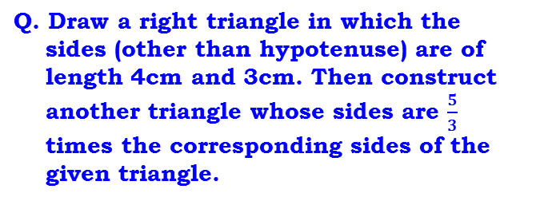
Ex-13.1 (Q.7)
A'
Rough Figure
Q. Draw a right triangle in which the
sides (other than hypotenuse) are of
length 4cm and 3cm. Then construct
another triangle whose sides are $\frac{5}{3}$
times the corresponding sides of the
given triangle.
Y as centre and with the same radius cut previously drawn arc
Now consider Radius = PQ
Now consider Radius = TU
B₃ as centre, and any suitable radius draw an arc intersecting BO and B₃C at point P & Q respectively
B as centre and any suitable radius, draw arcs intersecting BC at X and Y
C as centre, and any suitable radius draw an arc intersecting BC and AC at point T & U respectively
A′
X as centre and radius more than half of XY draw an arc
Now, B₅ as centre and with the same radius, Draw an arc intersecting BO at R
Considering any suitable radius, draw 5 arcs on ray BO
Now, C' as centre and with the same radius, Draw an arc intersecting BC at V
Any point on the line as centre and radius = 4 cm, draw an arc
C as the centre and same radius, draw another arc
A
Draw C'W intersecting AC at A'
Draw ray BZ
B as centre and r = 3cm
draw an arc and mark point A
Draw B₃C
Draw B₅S intersecting BC at C'
A
Draw ray BO
R as centre cut an arc, and mark that point S
V as centre cut an arc, and mark that point W
Draw AC
Draw seg BC = 4cm
Z
3 cm
1
2
3
4
5
6
7
8
9
10
11
12
13
14
15
1
2
3
3 cm
7
8
9
4
5
6
10
11
12
13
14
15
A′B
BC′
A′C′
5
C′
U
W
=
=
=
B
4 cm
C
AB
BC
AC
3
X
4 cm
C
V
1
2
3
B
Y
T
9
C'
1
2
3
4
5
6
7
8
4
9
5
6
7
8
10
11
12
13
14
15
10
11
12
13
14
15
B₁
Q
B₂
P
1
2
3
4
1
2
3
7
4
8
5
9
6
7
8
9
5
6
10
11
12
13
10
11
12
13
14
15
14
15
1
2
3
7
B₃
9
4
5
6
8
10
11
12
13
14
15
S
B₄
1
2
3
7
R
9
2
4
5
6
8
10
11
12
13
14
15
1
3
4
5
6
7
8
9
10
11
12
13
14
15
O
B₅

Slide 11

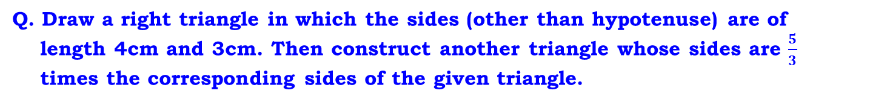
Q. Draw a right triangle in which the sides (other than hypotenuse) are of
length 4cm and 3cm. Then construct another triangle whose sides are $\frac{5}{3}$
times the corresponding sides of the given triangle.
Justification :
A'
∴
A′C′ ║ AC
[By construction]
A
ΔA′BC′ ∼ ΔABC
[AA Similarity]
A′B
BC′
A′C′
[Corresponding sides of
similar triangles]
=
=
3 cm
AB
BC
AC
BC′
BB$5$
5
B
4 cm
C
C'
but
=
=
[since ΔBB₃C ∼ ΔBB₅C^{l}]
BC
BB₃
3
B₁
∴
BC′
5
B₂
=
BC
3
B₃
∴
A′B
BC′
A′C′
5
B₄
=
=
=
AB
BC
AC
3
B₅
O

Slide 12
Module 10

Slide 13
CONSTRUCTIONS
To construct perpendicular from a point on a given line
To construct tangents to a circle from a point on the circle.
Notes:
School
13

Slide 14
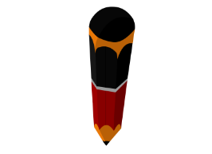
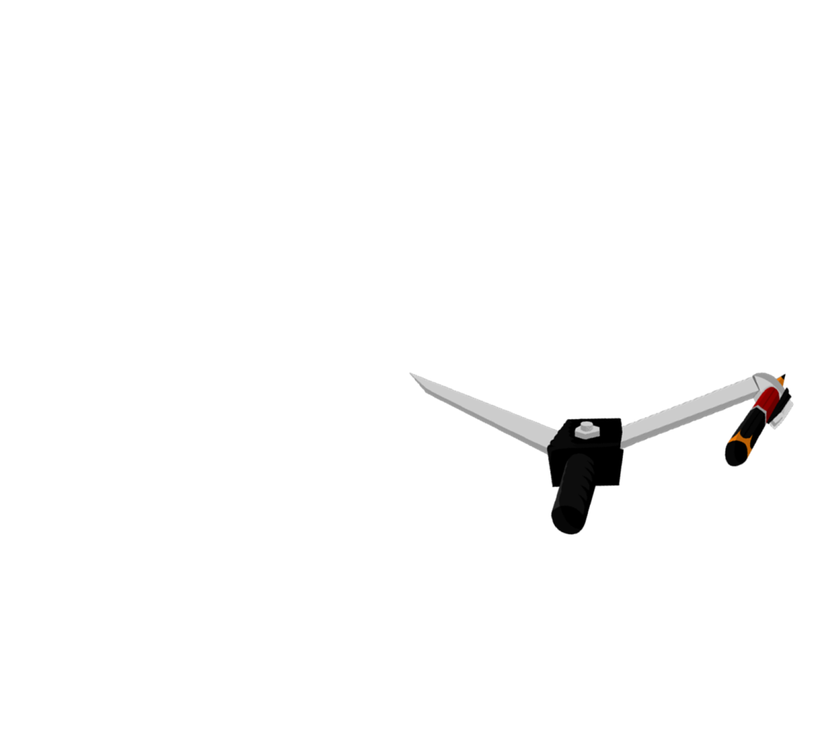
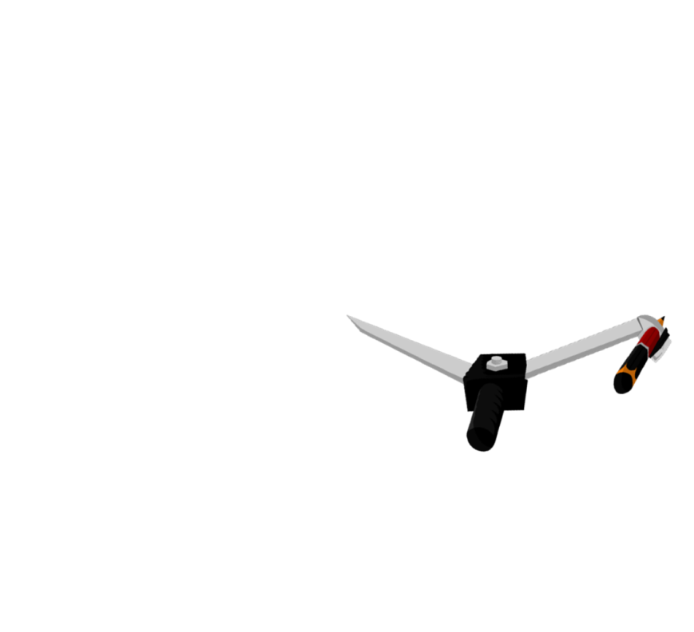
BASIC CONSRUCTIONS
To construct a perpendicular from a point on a given line.
m
With P as centre and any suitable radius, draw two arcs intersecting line l at points A and B.
With ‘A’ as centre and radius more than half of AB, draw an arc.
With ‘B’ as Centre and same radius, draw an intersecting arc.
Draw a line l
Take a point P on line l .
Draw line PQ
Q
Line m ⊥ line l
l
1
2
A
P
9
B
3
4
2
5
6
7
8
10
11
12
13
14
15
1
3
4
5
6
7
8
9
10
11
12
13
14
15

Slide 15
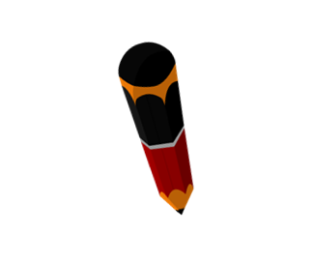
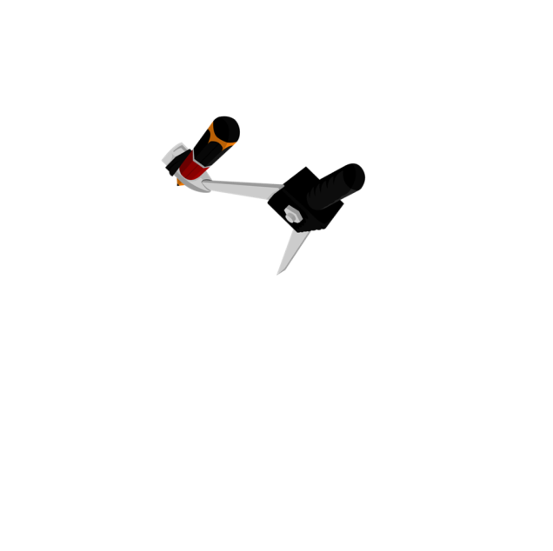



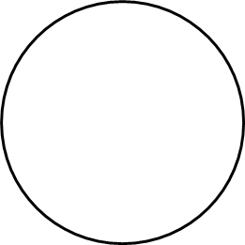






Q. Draw a tangent at any point ‘R’ on the circle
of radius 3.4 cm and centre ‘P’.
‘B’ as centre and same radius, draw an intersecting arc
Draw circle with centre P and radius 3.4cm
‘R’ as centre, and any suitable radius, draw arcs
‘A’ as centre and radius
more than half of ‘AB’,
draw an arc
Line l is the
required tangent.
Consider point R on the circle
Rough Figure
Produce PR
Draw line CR
Draw seg PR
P
R
3.4 cm
P
R

Slide 16
Module 11

Slide 17
CONSTRUCTIONS
To construct perpendicular bisector of a given line-segment.
To construct tangents to a circle from an external point.
Notes:
School
17

Slide 18
BASIC CONSRUCTIONS
To construct the perpendicular bisector of a given line segment
l
Now B as centre and with the same radius cut the previously drawn arcs
P
Draw line PQ
A as centre, radius more than half of AB, Draw arcs up and down
Let us draw perpendicular bisector of AB
A
M
B
1
2
3
4
5
6
7
8
9
10
11
12
13
14
15
1
2
3
4
5
6
7
8
9
10
11
12
13
14
15
Q

Slide 19
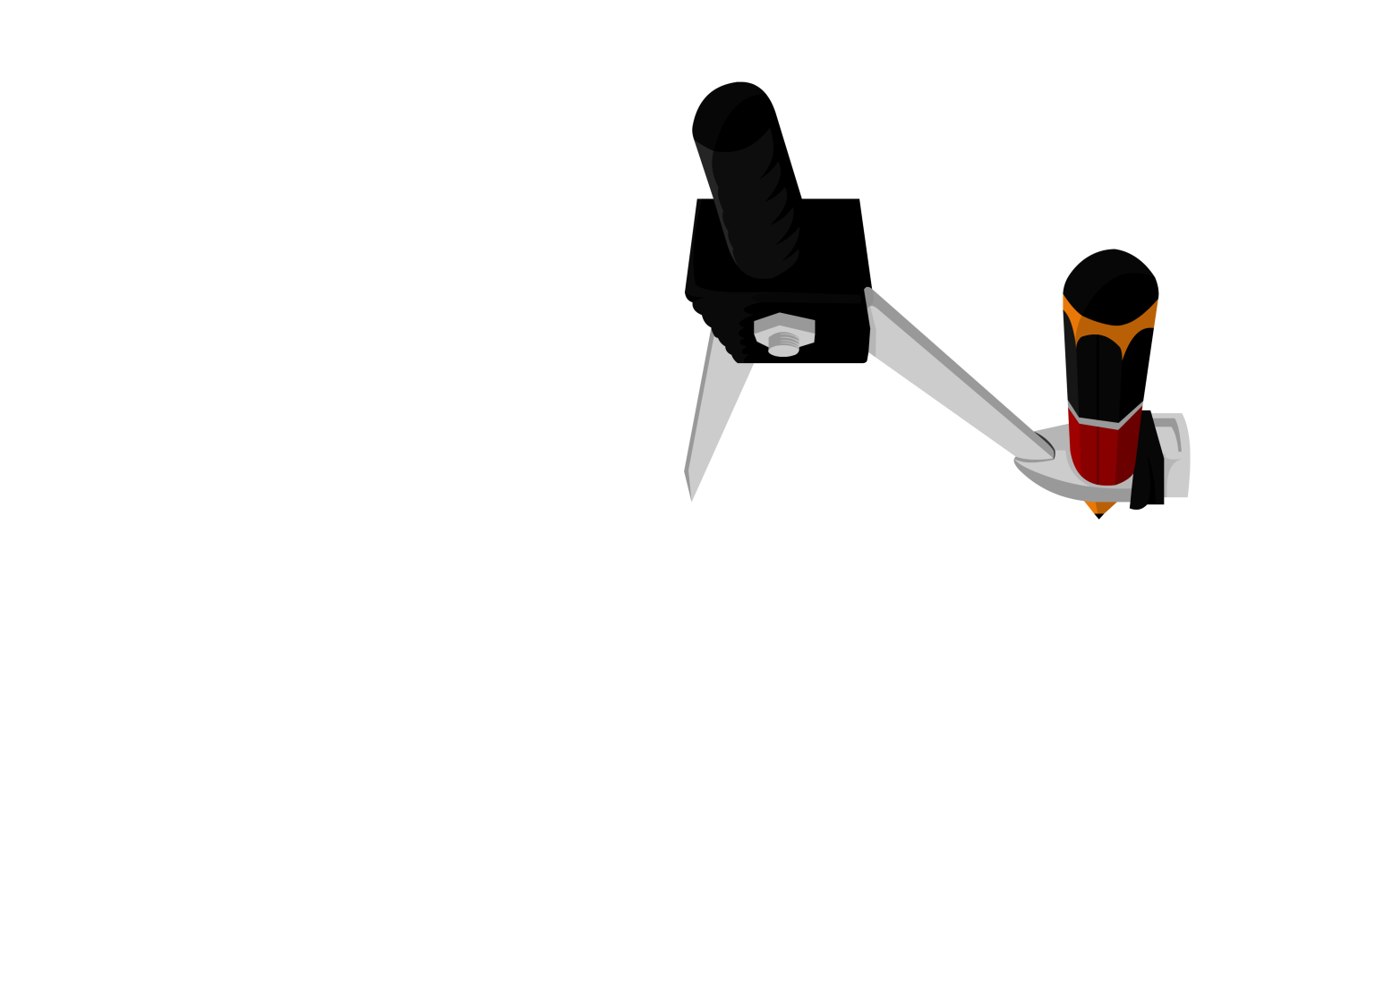

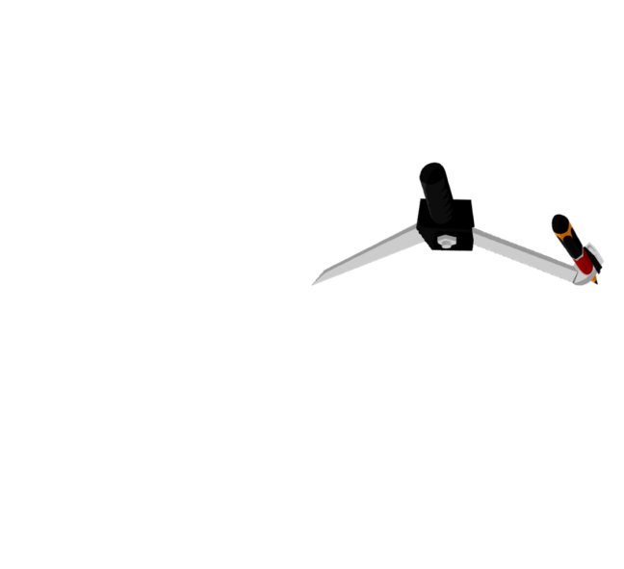
l
Q . Construct tangents to the circle from
point B with radius 3.5 cm and centre A.
Point B is at a distance 7.3 cm from the
centre.
Draw circle with
Centre A and
Radius 3.5 cm
Draw line l.
Line l is perpendicular bisector of seg AB.
‘A’ as centre and
radius 7.3cm, drawn an arc, mark point B
‘A’ as centre and radius more than half of seg AB, draw arcs
Let two circles intersects
at ‘C’ and ‘D’
‘M’ as centre and radius AM draw a circle
‘B’ as centre and same radius draw intersecting arcs
Now, Draw perpendicular
bisector of seg AB.
Draw a ray
Draw ray BC and ray BD
Draw radius AC = AD = 3.5cm
1
2
3
4
5
6
7
8
9
10
11
12
13
14
15
C
Rough figure
C
3.5 cm
3.5 cm
A
B
1
2
3
4
M
7
8
9
5
6
10
11
12
13
14
15
A
B
7.3 cm
7.3 cm
1
2
3
4
5
6
7
8
9
10
11
12
13
14
15
D
D
1
2
3
4
5
6
7
8
9
10
11
12
13
14
15
1
2
1
3
2
4
3
5
6
7
8
9
10
11
12
13
14
15
4
5
6
7
8
9
10
11
12
13
14
15

Slide 20
Q . Construct tangents to the circle from
point B with radius 3.5 cm and centre A.
Point B is at a distance 7.3 cm from the centre.
l
Justification :
Join AC then ∠ACB is an angle in a
semicircle.
C
∴
∠ACB = 90°
3.5 cm
∴
line BC ⊥ radius AC
A
B
M
∴
BC has to be a tangent to circle
7.3 cm
[A line perpendicular to radius to a circle at its outer end is a tangent]
D
Similarly BD is also a tangent to the circle.

Slide 21
Module 12

Slide 22
CONSTRUCTIONS
To construct tangents to a circle from an external point.
Notes:
School
22

Slide 23

Ex-13.2 (Q.1)
Q. Draw a circle of radius 6cm.
From a point 10cm away from
its centre, construct the pair
of tangents to the circle and
measure their lengths.
Q
X
6 cm
PQ and PR are required tangents from external point P
Draw a circle intersecting previously drawn circle at Q and R
Now P as centre and with the same radius, cut previously drawn arcs
1
2
3
4
5
6
7
8
9
10
11
12
13
14
15
O as centre and radius more than half of OP, draw arcs up and down
Draw a circle of radius of 6cm and centre O
Draw ray XY intersecting OP at M
Now M as centre and radius = OM/MP
Draw seg PQ and PR
Draw perpendicular bisector of seg OP
Draw seg OP = 10cm
PQ = PR = 8 cm
O
1
2
3
4
5
6
7
8
9
10
11
12
13
M
14
15
10 cm
P
1
2
1
3
2
4
3
5
4
6
5
7
6
8
7
9
8
9
10
11
12
13
14
15
10
11
12
13
14
15
1
2
3
4
5
6
7
8
9
10
11
12
13
14
15
Rough Figure
1
2
3
4
5
6
7
8
9
10
11
12
13
14
15
Q
6 cm
Y
O
10 cm
P
R
R
1
2
3
4
5
6
7
8
9
10
11
12
13
14
15

Slide 24
Q. Draw a circle of radius 6cm. From a point 10cm away from its centre,
construct the pair of tangents to the circle and measure their lengths.
Justification :
Join OQ then ∠PQO is an angle in a
semicircle.
Q
∴
∠PQO = 90°
6 cm
∴
line PQ ⊥ radius OQ
∴
PQ has to be a tangent to circle
O
10 cm
M
P
[A line perpendicular to radius
to a circle at its outer end is a
tangent]
Similarly PR is also a tangent to the circle.
R

Slide 25
Module 13

Slide 26
CONSTRUCTIONS
To construct tangents to a circle
from an external point.
Notes:
School
26

Slide 27



Ex-13.2 (Q.2)
Q. Construct a tangents to a circle of
radius 4cm from a point on the
concentric circle of radius 6cm
and measure its length. Also
verify the measurement by
actual calculations.
Now P as centre and with the same radius, cut previously drawn arcs
PQ and PR are required tangents from external point P
Draw line XY intersecting OP at M
Draw a circle intersecting previously drawn
circle(r = 4cm) at Q and R
O as centre and radius more than half of OP, draw arcs on either sides
Now, O as centre, Draw another circle of
radius 6cm
Now M as centre and radius = OM or MP
Q
Draw perpendicular bisector of seg OP
X
Draw a circle of radius
4 cm and centre O
Draw seg OP = 6cm
Draw ray PQ and PR
1
2
3
4
5
6
7
8
9
10
11
12
13
14
15
4 cm
O
6 cm
PQ = PR = 4.5 cm
1
2
3
4
5
6
7
8
9
10
11
M
P
1
2
12
13
14
15
3
4
5
6
7
8
9
10
11
12
13
14
15
1
2
3
4
5
6
7
8
9
10
11
12
13
14
15
1
2
3
Rough Figure
4
5
6
7
8
9
10
11
12
13
14
15
1
2
3
4
5
6
7
8
9
10
11
12
13
14
15
R
Y
Q
4 cm
O
6 cm
P
R
1
2
3
4
5
6
7
8
9
10
11
12
13
14
15

Slide 28
Module 14

Slide 29
CONSTRUCTIONS
To construct tangents to a circle
from an external point.
[continuation of the previous module]
Notes:
School
29

Slide 30

Q. Construct a tangent to a circle of radius 4cm from a point on the
concentric circle of radius 6cm and measure its length. Also verify the
measurement by actual calculations.
Calculation :
In ΔOQP,
∠OQP = 90º
Q
OP²
=
OQ²
+
PQ²
∴
PQ²
=
OP²
–
OQ²
4 cm
2
.
2
3
∴
PQ²
=
(6)²
–
(4)²
2
5.0000
O
6 cm
∴
PQ²
=
36
–
16
M
P
+
2
4
–
4
2
1
∴
PQ²
=
20
00
+
2
–
84
∴
PQ
=
20
44
3
16
00
+
3
–
1329
R
∴
PQ
=
2
5
∴
PQ
=
2
× 2.23
446
271
∴
PQ
=
4.5
…approx.

Slide 31
Q. Construct a tangent to a circle of radius 4cm from a point on the
concentric circle of radius 6cm and measure its length. Also verify the
measurement by actual calculations.
Justification :
Join OQ then ∠PQO is an angle in a
semicircle.
Q
∴
∠PQO = 90°
4 cm
∴
line PQ ⊥ radius OQ
O
6 cm
M
P
∴
PQ has to be a tangent to circle
[A line ⊥ to radius to a circle
at its outer end is a tangent]
Similarly PR is also a tangent to the circle.
R

Slide 32
Thank You

